Slide 1


International Economics: Theory and Policy
Twelfth Edition
Chapter 21
Optimum Currency Areas and the Euro
Copyright © 2022, 2018, 2015 Pearson Education, Inc. All Rights Reserved
Notes:
If this PowerPoint presentation contains mathematical equations, you may need to check that your computer has the following installed:
1) MathType Plugin
2) Math Player (free versions available)
3) NVDA Reader (free versions available)

Slide 2
Learning Objectives (1 of 2)
21.1 Discuss why Europeans have long sought to stabilize their mutual exchange rates while floating against the U.S. dollar.
21.2 Describe how the European Union, through the Maastricht Treaty of 1991, placed itself on the road to having a single currency, the euro, issued and managed by a European Central Bank (E C B).
21.3 Detail the structure of the E C B, the European System of Central Banks, and the European Union’s arrangements for coordinating member states’ economic policies.

Slide 3
Learning Objectives (2 of 2)
21.4 Articulate the main lessons of the theory of optimum currency areas.
21.5 Recount how the 19 countries using the euro have fared so far in their currency union, and the steps they are taking in response to their prolonged economic crisis.

Slide 4
Preview
The European Union
The European Monetary System
Policies of the E U and the E M S
Theory of optimal currency areas
Is the E U an optimal currency area?
Other considerations of an economic and monetary union

Slide 5
What Is the E U?
The European Union is a system of international institutions, the first of which originated in 1957, which now represents 27 European countries through the following bodies:
European Parliament: elected by citizens of member countries
Council of the European Union: appointed by governments of the member countries
European Commission: executive body
Court of Justice: interprets E U law
European Central Bank, which conducts monetary policy through a system of member country banks called the European System of Central Banks

Slide 6
What Is the E M S?
The European Monetary System was originally a system of fixed exchange rates implemented in 1979 through an exchange rate mechanism (E R M).
The E M S has since developed into an economic and monetary union (E M U), a more extensive system of coordinated economic and monetary policies.
The EMS has replaced the exchange rate mechanism for most members with a common currency under the economic and monetary union.

Slide 7
Membership of the Economic and Monetary Union
To be part of the economic and monetary union, E M S members must
adhere to the E R M: exchange rates were fixed in specified bands around a target exchange rate.
follow restrained fiscal and monetary policies as determined by Council of the European Union and the European Central Bank.
replace the national currency with the euro, whose circulation is determined by the European System of Central Banks.

Slide 8
Membership of the E U
To be a member of the E U, a country must, among other things,
have low barriers that limit trade and flows of financial assets
adopt common rules for emigration and immigration to ease the movement of people
establish common workplace safety and consumer protection rules
establish certain political and legal institutions that are consistent with the E U’s definition of liberal democracy.

Slide 9
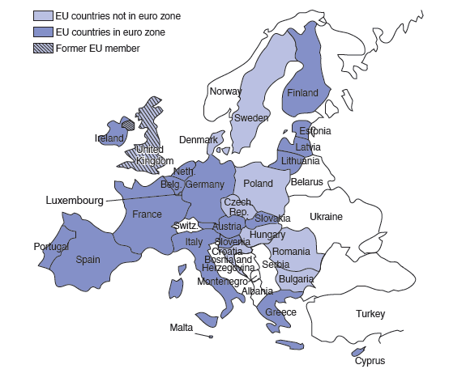
Figure 21.1 Members of the Euro Zone as of January 1, 2021
The heavily shaded countries on the map are the 19 members of EMU: Austria, Belgium, Cyprus, Estonia, Finland, France, Germany, Greece, Ireland, Italy, Latvia, Lithuania, Luxembourg, Malta, the Netherlands, Portugal, the Slovak Republic, Slovenia, and Spain. The United Kingdom never adopted the euro, and it left the EU in 2020 owing to the exit referendum of June 2016.

Slide 10
Table 21.1 A Brief Glossary of Euronyms
E C B | European Central Bank
E E A | European Economic Area
E F S F | European Financial Stability Facility
E M S | European Monetary System
E M U | Economic and Monetary Union
E R M | Exchange Rate Mechanism
E S C B | European System of Central Banks
E S M | European Stability Mechanism
E U | European Union
O M T | Outright Monetary Transactions
S G P | Stability and Growth Pact
S R M | Single Resolution Mechanism
S S M | Single Supervisory Mechanism

Slide 11
Why the E U?
Countries that established the E U and E M S had several goals
To enhance Europe’s power in international affairs: as a union of countries, the E U could represent more economic and political power in the world.
To make Europe a unified market: a large market with free trade, free flows of financial assets, and free migration of people—in addition to fixed exchange rates or a common currency—was believed to foster economic growth and economic well-being.
To make Europe politically stable and peaceful.

Slide 12
Why the Euro (E M U)?
E U members adopted the euro for four main reasons:
Unified market: the belief that greater market integration and economic growth would occur.
Political stability: the belief that a common currency would make political interests more uniform.
The belief that German influence under the E M S would be moderated under a European System of Central Banks.
Elimination of the possibility of devaluations/ revaluations: with free flows of financial assets, capital flight and speculation could occur in an E M S with separate currencies, but it would be more difficult for them to occur in an E M S with a single currency.

Slide 13
The E M S: 1979–1998 (1 of 4)
From 1979 to 1993, the E M S defined the exchange rate mechanism to allow most currencies to fluctuate
around target exchange rates.
The exchange rate mechanism allowed larger fluctuations
for currencies of Portugal, Spain, Britain (until
1992), and Italy (until 1990).
These countries wanted greater flexibility with monetary policy.
The wider bands were also intended to prevent speculation caused by differing monetary and fiscal policies.

Slide 14
The EMS: 1979–1998 (2 of 4)
To prevent speculation,
early in the E M S some exchange controls were also enforced to limit trading of currencies.
But from 1987 to 1990 these controls were lifted in order to make the E U a common market for financial assets.
A credit system was also developed among E M S members to lend to countries that needed assets and currencies that were in high demand in the foreign exchange markets.

Slide 15
The EMS: 1979–1998 (3 of 4)
But because of differences in monetary and fiscal policies across the E M S, market participants began buying German assets (because of high German interest rates) and selling other E M S assets.
As a result, Britain left the E M S in 1992 and allowed the pound to float against other European currencies.
As a result, the exchange rate mechanism was redefined
in 1993 to allow for bands of
of the target value in
order devalue many currencies relative to the deutschemark.

Slide 16
The EMS: 1979–1998 (4 of 4)
But eventually, each E M S member adopted similarly restrained fiscal and monetary policies, and the inflation rates in the E M S eventually converged (and speculation slowed or stopped).
In effect, E M S members were following the restrained monetary policies of Germany, which has traditionally had low inflation.
Under the E M S exchange rate mechanism of fixed bands, Germany was “exporting” its monetary policy.

Slide 17
Brexit (1 of 2)
On June 23, 2016, British citizens voted to leave the E U.
Britain had never adopted the euro.
Stock markets across the world tumbled, and the pound sterling plummeted.
Voters want to limit immigration from Eastern Europe, and the benefits, such as medical care, the U K government must provide immigrants under E U law.
Desire to “Take Back Control” from E U regulations in many dimensions.
Britain had to negotiate trade deals with every county.

Slide 18
Brexit (2 of 2)
Under 2019 withdrawal agreement bill, Brexit took place January 31, 2020 with an 11-month transition period during which Britain continued to follow E U rules and kept frictionless trade with other E U countries.
Added time to negotiate permanent trade agreements.
A last minute deal achieved mostly tariff and quota-free trade between Britain and the E U.
To keep boundary between Northern Ireland (part of United Kingdom) and the Republic of Ireland free of border controls led to Northern Ireland still partially in the E U single market and administrative checks on imports.

Slide 19
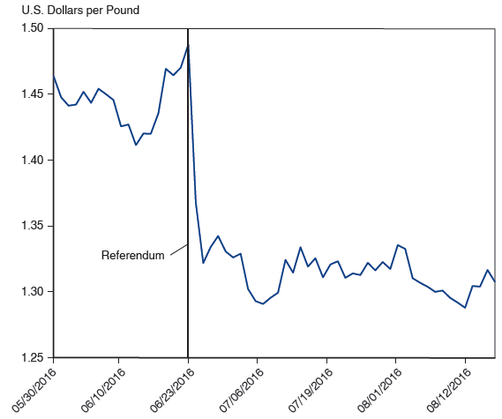
U.S. Dollars per Pound, 05/2016-08/2018
Source: Global financial data.
Notes:
The plot U S dollars per pound dips from 1.46 on May 30 to 1.42 after June 10. The rate then rose to 1.48 on June 23. This is the date of the Britain’s referendum to leave the E U. The week following the vote, the rate dropped to 1.32, to 1.28 after July 6. The rate then continued to fluctuate between 1.30 and 1.35 past August 12. All values estimated.

Slide 20
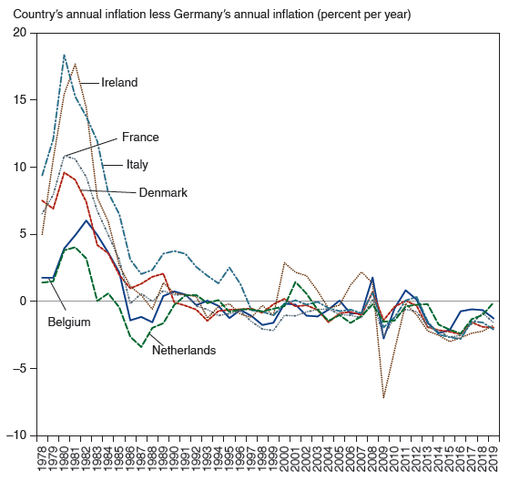
Figure 21.2 Inflation Convergence for Six Original E M S Members, 1978–2019
Shown are the differences between domestic inflation and German inflation for six of the original EMS members: Belgium, Denmark, France, Ireland, Italy, and the Netherlands.
Source: CPI inflation rates from International Monetary Fund, International Financial Statistics, and B L S.
Notes:
The horizontal axis ranges from 19 78 to 20 19 in increments of 1 year. The vertical axis ranges from negative 10 to 20 in increments of 5. The annual inflation line for Ireland starts at (19 79, 5), rises to (19 82, 17), falls to (19 87, 0), rises and falls intermittently, and then rises to (2001, 3.4). The annual inflation falls to (2009, negative 7.2), rises to (20 12, negative 0.2), and then ends at (20 19, negative 2). The inflation rate for Italy starts at (19 78, 9.1), passes through (19 81, 18), (19 88, 2.2), (19 99, negative 0.2), and ends at (20 19, negative 1.2). The inflation rate for France starts at (19 78, 6.2), passes through (19 81, 11), (19 88, 0), (19 99, negative 0.2), and ends at (20 19, negative 0.8). The inflation rate for Denmark starts at (19 78, 7.8), passes through (19 81, 8.9), (19 87, 1), (2001, 0.1), and ends at (20 19, negative 1.3). The inflation rate for Belgium starts at (19 78, 1.8), passes through (19 81, 4.1), (19 88, negative 1), (19 99, negative 1.2), and ends at (20 19, negative 0.7). The inflation rate for Netherlands starts at (19 78, 1.6), passes through (19 84, 5.8), (19 88, negative 2.1), (19 99, negative 0.9), and ends at (20 19, negative 0.2). All values are estimated.

Slide 21
Policies of the E U and E M S (1 of 4)
The Single European Act of 1986 recommended that many barriers to trade, financial asset flows, and immigration be removed by December 1992.
It also allowed E U policy to be approved with less than unanimous consent among members.
The Maastricht Treaty, proposed in 1991, required the three provisions to transform the E M S into an economic and monetary union.
It also required standardizing regulations and centralizing foreign and defense policies among E U countries.
Some E U/E M S members have not ratified all of the clauses.

Slide 22
Policies of the E U and E M S (2 of 4)
The Maastricht Treaty requires that members that want to enter the economic and monetary union
attain exchange rate stability defined by the E R M before adopting the euro.
attain price stability: a maximum inflation rate of 1.5% above the average of the three lowest national inflation rates among E U members.
maintain a restrictive fiscal policy:
a maximum ratio of government deficit to G D P of 3%.
a maximum ratio of government debt to G D P of 60%.

Slide 23
Policies of the E U and E M S (3 of 4)
The Maastricht Treaty requires that members that want to remain in the economic and monetary union
maintain a restrictive fiscal policy:
a maximum ratio of government deficit to G D P of 3%.
a maximum ratio of government debt to G D P of 60%.
Financial penalties are imposed on countries with “excessive” deficits or debt.
The Stability and Growth Pact, negotiated in 1997, also allows for financial penalties on countries with “excessive” deficits or debt.

Slide 24
Policies of the EU and EMS (4 of 4)
The euro was adopted in 1999, and the previous exchange rate mechanism became obsolete.
But a new exchange rate mechanism—E R M 2—was established between the economic and monetary union and outside countries.
It allowed countries (either within or outside the E U) that wanted to enter the economic and monetary union in the future to maintain stable exchange rates before doing so.
It allowed E U members outside of the economic and monetary union to maintain fixed exchange rates if desired.

Slide 25
Theory of Optimum Currency Areas (1 of 12)
The theory of optimum currency areas argues that the optimal area for a system of fixed exchange rates, or a common currency, is one that is highly economically integrated.
economic integration means free flows of
goods and services (trade)
financial capital (assets) and physical capital
workers/labor (immigration and emigration)
The theory was developed by Robert Mundell in 1961.

Slide 26
Theory of Optimum Currency Areas (2 of 12)
Fixed exchange rates have costs and benefits for countries deciding whether to adhere to them.
Benefits of fixed exchange rates are that they avoid the uncertainty and international transaction costs that floating exchange rates involve.
The gain that would occur if a country joined a fixed exchange rate system is called the monetary efficiency gain.

Slide 27
Theory of Optimum Currency Areas (3 of 12)
The monetary efficiency gain of joining a fixed exchange rate system depends on the amount of economic integration.
Joining fixed exchange rate system would be beneficial for a country if
trade is extensive between it and member countries, because transaction costs would be greatly reduced.
financial assets flow freely between it and member countries, because the uncertainty about rates of return would be greatly reduced.
people migrate freely between it and member countries, because the uncertainty about the purchasing power of wages would be greatly reduced.

Slide 28
Theory of Optimum Currency Areas (4 of 12)
In general, as the degree of economic integration increases, the monetary efficiency gain increases.
Draw a graph of the monetary efficiency gain as a function of the degree of economic integration.

Slide 29
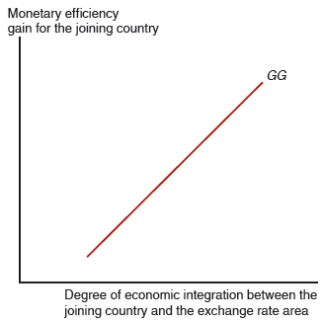
Figure 21.3 The G G Schedule
The upward-sloping G G schedule shows that a country’s monetary efficiency gain from joining a fixed exchange rate area rises as the country’s economic integration with the area rises.

Slide 30
Theory of Optimum Currency Areas (5 of 12)
When considering the monetary efficiency gain,
we have assumed that the members of the fixed exchange rate system would maintain stable prices.
But when variable inflation exists among member countries, then joining the system would not reduce uncertainty (as much).
we have assumed that a new member would be fully committed to a fixed exchange rate system.
But if a new member is likely to leave the fixed exchange rate system, then joining the system would not reduce uncertainty (as much).

Slide 31
Theory of Optimum Currency Areas (6 of 12)
Economic integration also allows prices to converge between members of a fixed exchange rate system and a potential member.
The law of one price is expected to hold better when markets are integrated.

Slide 32
Theory of Optimum Currency Areas (7 of 12)
Costs of fixed exchange rates are that they require the loss of monetary policy for stabilizing output and employment, and the loss of automatic adjustment of exchange rates to changes in aggregate demand.
Define this loss that would occur if a country joined a fixed exchange rate system as the economic stability loss.

Slide 33
Theory of Optimum Currency Areas (8 of 12)
The economic stability loss of joining a fixed exchange rate system also depends on the amount of economic integration.
After joining a fixed exchange rate system, if the new member faces a fall in aggregate demand:
Relative prices will tend to fall, which will lead other members to increase aggregate demand greatly if economic integration is extensive, so that the economic loss is not as great.
Financial assets or labor will migrate to areas with higher returns or wages if economic integration is extensive, so that the economic loss is not as great.

Slide 34
Theory of Optimum Currency Areas (9 of 12)
The loss of the automatic adjustment of flexible exchange rates is not as great if goods and services markets are integrated. Why?
Consider what would have happened if the country did not join the fixed exchange rate system:
the automatic adjustment would have caused a depreciation of the domestic currency and an appreciation of foreign currencies, which would have caused an increase in many prices for domestic consumers when goods and services markets are integrated.

Slide 35
Theory of Optimum Currency Areas (10 of 12)
In general, as the degree of economic integration increases, the economic stability loss decreases.
Draw a graph of the economic stability loss as a function of the degree of economic integration.

Slide 36
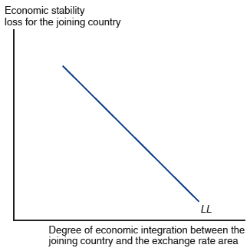
Figure 21.4 The L L Schedule
The downward-sloping L L schedule shows that a country’s economic stability loss from joining a fixed exchange rate area falls as the country’s economic integration with the area rises.

Slide 37
Theory of Optimum Currency Areas (11 of 12)
At some critical point measuring the degree of integration, the monetary efficiency gain will exceed the economic stability loss for a member considering whether to join a fixed exchange rate system.

Slide 38
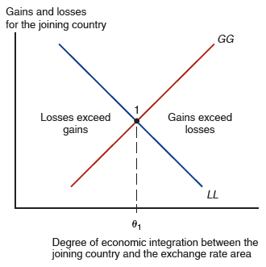
Figure 21.5 Deciding When to Peg the Exchange Rate
The intersection of G G and L L at point 1 determines a critical level of economic
integration,
between a fixed exchange rate area and a country considering
whether to join. At any level of integration above
the decision to join yields
positive net economic benefits to the joining country.
Notes:
The G G schedule and L L schedule intersect at point 1. Losses exceed gains in the area left of point 1, where x = theta sub 1. Losses exceed gains to the left of point 1, and gains exceed losses to the right of point 1.

Slide 39
Theory of Optimum Currency Areas (12 of 12)
There could be an event that causes the frequency or magnitude of changes in aggregate demand to increase for a country.
If so, the economic stability loss would be greater for every measure of economic integration between a new member and members of a fixed exchange rate system.
How would this affect the critical point where the monetary efficiency gain equals economic stability loss?

Slide 40
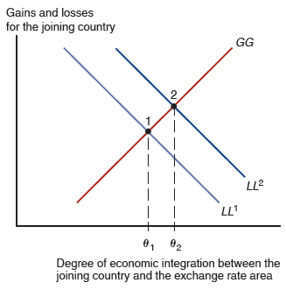
Figure 21.6 An Increase in Output Market Variability
A rise in the size and frequency of country-specific disturbances to the joining country’s
product markets shifts the L L schedule upward from
because for a given level of
economic integration with the fixed exchange rate area, the country’s economic stability loss from pegging its exchange rate rises. The shift in L L raises the critical level of
economic integration at which the exchange rate area is joined to
Notes:
The rising G G schedule intersects the falling L L super 1 schedule at point 1, where x = theta sub 1. Schedule L L super 2 is shifted up and to the right, with a new intersection at point 2, where x = theta sub 2, to the right of x= theta sub 1.

Slide 41
Is the E U an Optimum Currency Area? (1 of 4)
If the E U/E M S/economic and monetary union can be expected to benefit members, we expect that its members have a high degree of economic integration:
large trade volumes as a fraction of G D P
a large amount of foreign financial investment and foreign direct investment relative to total investment
a large amount of migration across borders as a fraction of total labor force

Slide 42
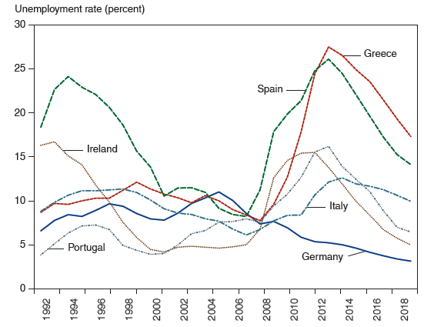
Figure 21.7 Unemployment Rates in Selected E U Countries
Widely divergent unemployment rates moved closer together after the euro’s launch in 1999 but since the late 2000s have moved sharply apart again.
Source: International Monetary Fund, World Economic Outlook database, April 2020. Numbers for 2020 are I M F forecasts.
Notes:
The plot for Spain generally falls from (19 94, 24) through (2000, 14) to (2007, 7) and then rises to (20 12, 26) and falls to (20 16, 20). The plot for Ireland generally falls from (19 92, 16) to (2000, 4) and then rises to (2007, 5); the plot then rises sharply to (20 12, 15) and falls to (20 16, 7). The plot for Greece generally rises from (19 92, 8) to (19 98, 13) and then generally falls through (2000, 10) to (2008, 7), before rising sharply to (20 14, 27) and falling to (20 16, 25). The plot for Italy rises from (19 92, 8) to 19 96, 11) and then generally falls through (2000, 10) to (2007, 6), before generally rising to (20 16, 12). The plot for Germany generally rises from (19 92, 6) through (2000, 7) to (2006, 11) and then generally falls to (20 16, 5). The plot for Portugal rises from (19 92, 4) to (19 96, 6) and then falls to (2000, 4) before rising again through (2008, 7) to (20 14, 16) and falling to (20 16, 12). All values are estimated.

Slide 43
Is the E U an Optimum Currency Area? (2 of 4)
Deviations from the law of one price also occur in many E U markets.
If E U markets were greatly integrated, then the (currency-adjusted) prices of goods and services should be nearly the same across markets.
The price of the same B M W car varies 29.5% between British and Dutch markets.

Slide 44
Is the E U an Optimum Currency Area? (3 of 4)
Regional migration is not extensive in the E U.
Europe has many languages and cultures, which hinder migration and labor mobility.
Unions and regulations also impede labor movements between industries and countries.
Differences of U.S. unemployment rates across regions are smaller and less persistent than differences of national unemployment rates in the E U, indicating a lack of E U labor mobility.

Slide 45
Table 21.2 People Changing Region of Residence in the 1990s (Percent of Total Population)
Britain | Germany | Italy | United States
1.7 | 1.1 | 0.5 | 3.1
Sources: Peter Huber, “Inter-regional Mobility in Europe: A Note on the Cross-Country Evidence,” Applied Economics Letters 11 (August 2004), pp. 619–624; and “Geographical Mobility, 2003–2004,” U.S. Department of Commerce, March 2004. Table data are for Britain in 1996, Germany in 1990, Italy in 1999, and the United States in 1999.

Slide 46
Table 21.3 Assets of Some Individual Banks as a Ratio to National Output, End-2011
Bank | Home country | Bank assets
Erste Group Bank | Austria | 0.68
Dexia | Belgium | 1.10
BNP Paribus | France | 0.97
Deutsche Bank | Germany | 0.82
Bank of Ireland | Ireland | 0.95
UniCredit | Italy | 0.59
ING Group | Netherlands | 2.12
Banco Commercial Portugues | Portugal | 0.57
Banco Santander | Spain | 1.19
Source: G D P data from International Monetary Fund, World Economic Outlook database. Data on bank assets from Viral V. Acharya and Sascha Steffen, “The ‘Greatest’ Carry Trade Ever? Understanding Eurozone Bank Risks,” Discussion Paper 9432, Centre for Economic Policy Research, April 2013.

Slide 47
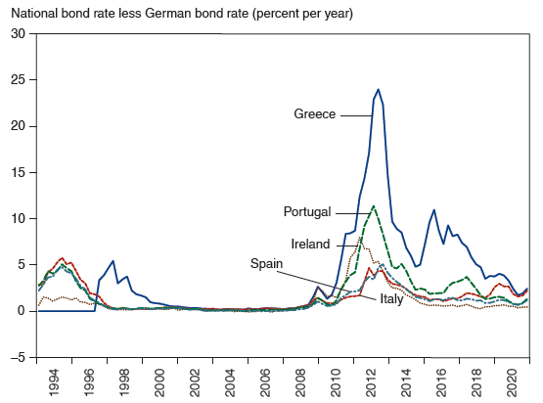
Figure 21.8 Nominal Government Borrowing Spreads Over Germany
Euro countries’ long-term government bond yields converged to Germany’s level as they prepared to join the euro. The yields began to diverge again with the global financial crisis of 2007–2009 and moved sharply apart after the euro crisis broke out late in 2009.
Source: Federal Reserve Economic Data (F R E D), 10-year government bond yields.
Notes:
From 19 98 to 2007, the plots for 5 countries, Italy, Spain, Ireland, Portugal, and Germany, between a range of negative 1 and 1. In 20 12, plots spike to varying points and diverge through 20 16. The plot for Italy spikes to 4 in 20 12 and generally falls to 1 in 20 16. The plot for Spain spikes to 5 in the beginning of 20 14 and generally falls to 2 in 20 16. The plot for Ireland spikes to 7 in 20 12 and generally falls to 1 in 20 16. The plot for Portugal spikes to 12 in 20 12 and generally falls to 3 in 20 16. The plot for Greece spikes to 36 in 20 12, generally falls to 5 at the beginning to 20 16, spikes again to 15, and then falls to 8, during 20 16. All values are estimated.

Slide 48
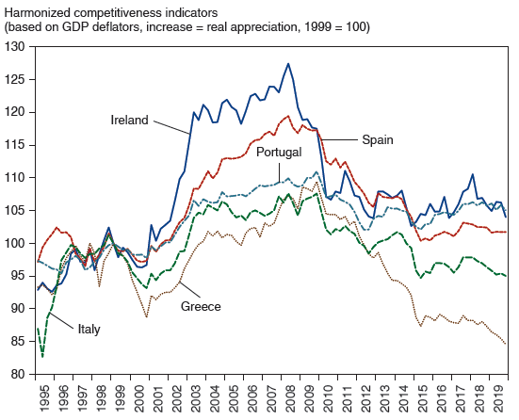
Figure 21.9 Real Appreciation in Peripheral Euro Zone Countries
After entry into the euro, real appreciation set in for peripheral euro zone countries, most noticeably the two with massive housing booms, Ireland and Spain.
Source: E C B. Harmonized multilateral competitiveness index based on G D P deflators. An increase in the index is a real appreciation (loss in competitiveness).
Notes:
The graph plots 5 countries: Italy, Greece, Portugal, Spain, and Ireland. In 19 97, the plots for all countries range between roughly 96 and 102. From 2001 to 19 99, the plots rise to at varying rates. The plot for Italy generally rises from (2001, 95) to (2009, 107) and then generally falls to (20 15, 96). The plot for Greece generally rises from (2001, 92) to (2009, 110) and then generally falls to (20 15, 87). The plot for Portugal generally rises from (2001, 98) to (2009, 111) and then generally falls to (20 15, 105). The plot for Spain generally rises from (2001, 97) to (2009, 117) and the generally falls to (20 15, 102). The plot for Ireland generally rises from (2001, 100) to (2009, 120) and then generally falls to (20 15, 98). All values estimated.

Slide 49
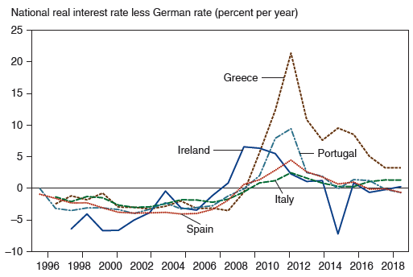
Figure 21.10 Divergent Real Interest Rates in the Euro Zone
As the 1999 launch date for the euro approached, nominal long-term bond rates in prospective member countries converged, leading to lower real interest rates in those countries with relatively high inflation. The graph shows each country’s long-term real interest rate minus Germany’s long-term real interest rate. Real interest rates are average nominal rates on 10-year government bonds minus the same year’s inflation rate.
Source: Federal Reserve Economic Data (F R E D). Long-term government bond yields (10-year maturity, not seasonally adjusted, and G D P implicit price deflator index (2015 = 100).
Notes:
The graph for Ireland rises from (19 97, negative 7.5), through (2003, 0), (2008, 8), (20 14, negative 5), and (20 18, 0). The graph for Greece rises from (19 96, 0), through (2008, negative 5), (20 12, 22), and (20 18, 5). The graph for Italy rises from (19 97, 0), through (2006, negative 2), (20 12, 1), (20 14, 0), and (20 18, 0). The graph for Spain falls from (19 96, 0), through (2008, negative 1), (20 12, 5), and (20 18, 1). The graph for Portugal rises from (19 97, 0), through (2006, negative 2), (2008, 10), (20 14, negative 7), and (20 18, 0). All values are estimated.

Slide 50
Table 21.4 Current Account Balances of Euro Zone Countries, 2005–2009 (percent of G D P)
blank | Greece | Ireland | Italy | Portugal | Spain | Germany
2005 | negative 7.5 | negative 3.5 | negative 1.7 | negative 9.4 | negative 7.4 | 5.1
2006 | negative 11.2 | negative 4.1 | negative 2.6 | negative 9.9 | negative 9.0 | 6.5
2007 | negative 14.6 | negative 5.3 | negative 2.4 | negative 9.4 | negative 10.0 | 7.6
2008 | negative 14.6 | negative 5.3 | negative 2.6 | negative 12.0 | negative 9.8 | 6.7
2009 | negative 11.2 | negative 2.9 | negative 3.1 | negative 10.3 | negative 5.4 | 5.0

Slide 51
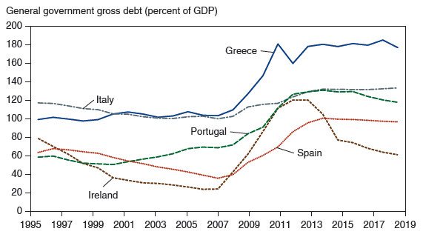
Figure 21.11 Gross Public Debt to G D P Ratios in the Euro Area
Public debts in the euro area grew rapidly after 2007, in part due to the need for governments to support their weak banks.
Source: International Monetary Fund, World Economic Outlook database, October 2019.
Notes:
The graph plots 5 countries: Italy, Greece, Portugal, Spain, and Ireland. The plot for Italy generally falls from (19 95, 110) to (2007, 100) and then rises to (20 15, 132). The plot for Greece generally rises from (19 95, 95) through (2007, 102) to (20 15, 178). The plot for Portugal generally falls from (19 95, 59) to (2000, 50) and then generally rises through (2007, 70) to (20 15, 128). The plot for Spain generally falls from (19 95, 63) to (2007, 37) and then rises to (20 15, 99). The plot for Ireland falls from (19 95, 80) to (2007, 22) and then rises to (20 13, 121) and falls to (20 15, 98). All values are estimated.

Slide 52
Is the E U an Optimum Currency Area? (4 of 4)
There is evidence that financial assets were able to move more freely within the E U after 1992 and 1999.
But capital mobility without labor mobility can make the economic stability loss greater.
After a reduction of aggregate demand in a particular E U country, financial assets could be easily transferred elsewhere while labor is stuck.
The loss of financial assets could further reduce production and employment.

Slide 53
Other Considerations for an E M U (1 of 3)
The structure of the economies in the EU’s economic and monetary union is important for determining how members respond to aggregate demand shocks.
The economies of E U members are similar in the sense that there is a high volume of intra-industry trade relative to the total volume.
They are different in the sense that Northern European countries have high levels of physical capital per worker and more skilled labor, compared with Southern European countries.

Slide 54
Other Considerations for an E M U (2 of 3)
How an E U member responds to aggregate demand shocks may depend on how the structure of its economy compares to that of fellow E U members.
For example, the effects on an E U member of a reduction in aggregate demand caused by a reduction in demand in the software industry will depend on whether the E U member has a large number of workers skilled in programming relative to fellow E U members.

Slide 55
Other Considerations for an E M U (3 of 3)
The amount of transfers among the E U members may also affect how E U economies respond to aggregate demand shocks.
Fiscal payments between countries in the E U’s federal system, or fiscal federalism, may help offset the economic stability loss from joining an economic and monetary union.
But relative to interregional transfers in the United States, little fiscal federalism occurs among E U members.

Slide 56
The Future of E M U (1 of 2)
E M U must overcome some difficult challenges, however, if it is to survive its current crisis and prosper.
Europe is not an optimum currency area. Therefore, asymmetric economic developments within different countries of the euro zone—developments that might well call for different national interest rates under a regime of individual national currencies—will remain hard to handle through monetary policy.

Slide 57
The Future of E M U (2 of 2)
In most E U countries, labor markets remain highly unionized and subject to employment taxes and regulations that impede labor mobility between industries and regions. The result has been persistently high levels of unemployment. Unless labor markets become much more flexible, individual euro zone countries will have a hard time adjusting toward full employment and competitive real exchange rates. Other structural problems also abound.
Thus, the euro faces significant challenges in the years ahead.

Slide 58
Summary (1 of 3)
The E M S was first a system of fixed exchange rates but later developed into a more extensive coordination of economic and monetary policies: an economic and monetary union.
The Single European Act of 1986 recommended that E U members remove barriers to trade, capital flows, and immigration by the end of 1992.
The Maastricht Treaty outlined three requirements for the E M S to become an economic and monetary union.
It also standardized many regulations and gave the E U institutions more control over defense policies.
It also set up penalties for spendthrift E M U members.

Slide 59
Summary (2 of 3)
A new exchange rate mechanism was defined in 1999 vis-à-vis the euro, when the euro came into existence.
An optimum currency area is a union of countries with a high degree of economic integration among goods and services, financial assets, and labor markets.
It is an area where the monetary efficiency gain of joining a fixed exchange rate system is at least as large as the economic stability loss.

Slide 60
Summary (3 of 3)
The E U does not have a large degree of labor mobility due to differences in culture and due to unionization and regulation.
The E U is not an optimum currency area.

Slide 61

Copyright
This work is protected by United States copyright laws and is provided solely for the use of instructors in teaching their courses and assessing student learning. Dissemination or sale of any part of this work (including on the World Wide Web) will destroy the integrity of the work and is not permitted. The work and materials from it should never be made available to students except by instructors using the accompanying text in their classes. All recipients of this work are expected to abide by these restrictions and to honor the intended pedagogical purposes and the needs of other instructors who rely on these materials.

